Slide 1

Wellness Guide
Dinacharya

Slide 2
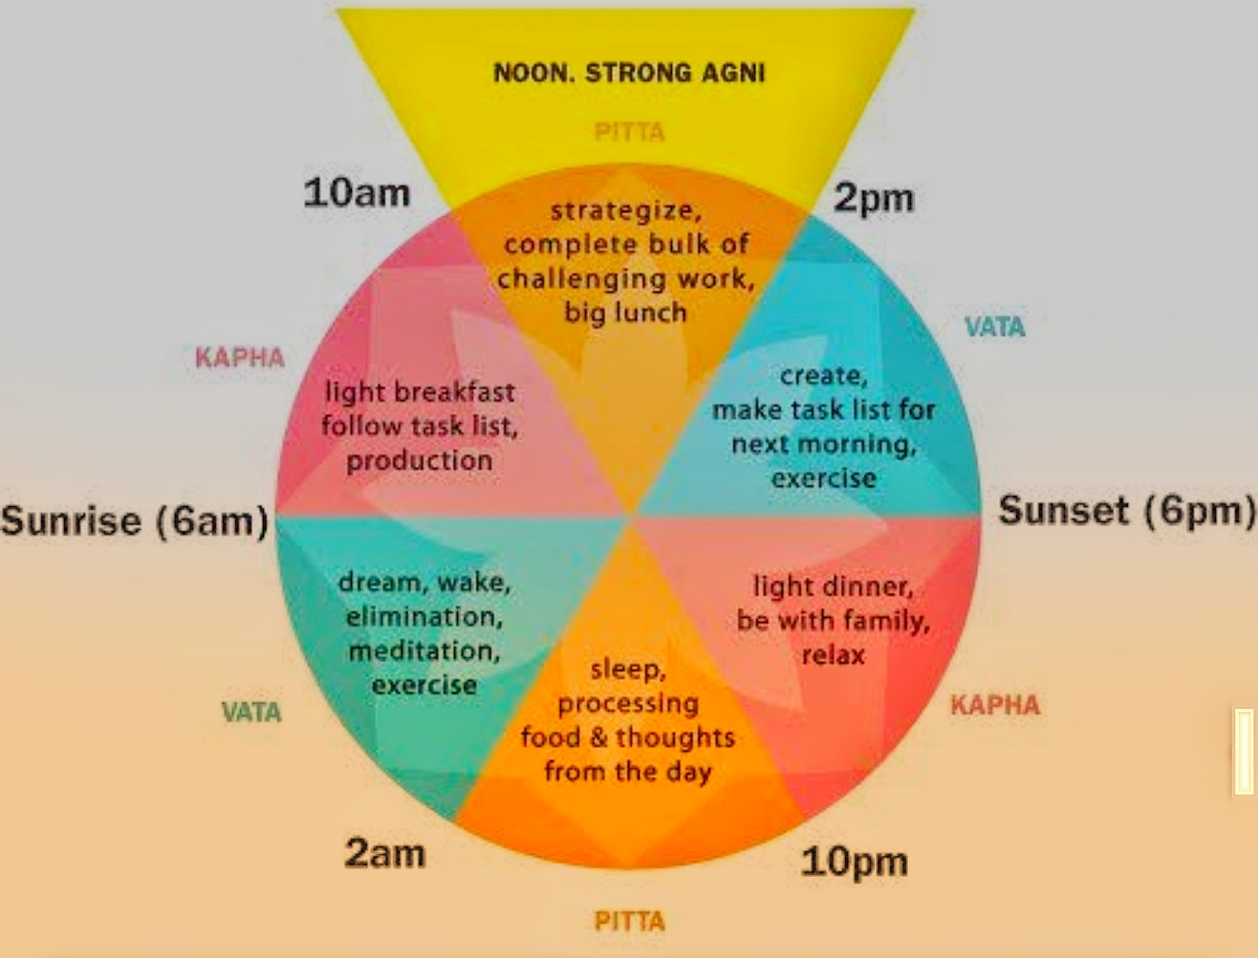

Slide 3
Wellness Guide – Aligns our sysyem more closely with the cycles of nature

